Slide 1
Linux device driver
Day 13 PPT
-SUBITHRA s

Slide 2
Pthread_cond_signal
Purpose: pthread_cond_signal is used by a thread to wake up one waiting thread that is waiting on the condition variable.
Operation: when pthread_cond_signal is called, it wakes up one of the threads waiting on the condition variable. If multiple threads are waiting, which thread wakes up is unspecified.
Usage: used to notify other threads that a condition has changed and they can proceed.

Slide 3
Pthread_cond_wait Purpose: pthread_cond_wait is used by a thread to wait on a condition variable until another thread signals that the condition has changed. Operation: the thread calling pthread_cond_wait atomically releases the associated mutex and enters a wait state. It waits for another thread to signal the condition variable. When the condition is signaled, the thread wakes up, reacquires the mutex, and continues execution. Usage: typically used in a loop that checks for a certain condition before waiting on the condition variable.

Slide 4
pthread_exit
Purpose: pthread_exit is used to terminate the execution of the calling thread. It allows the thread to exit while other threads continue to execute.
Functionality: When pthread_exit is called, the current thread exits, and control is returned to the thread that created it
Return Value: pthread_exit can optionally return a value to the thread's creator. The returned value can be accessed by the thread's creator using pthread_join.

Slide 5
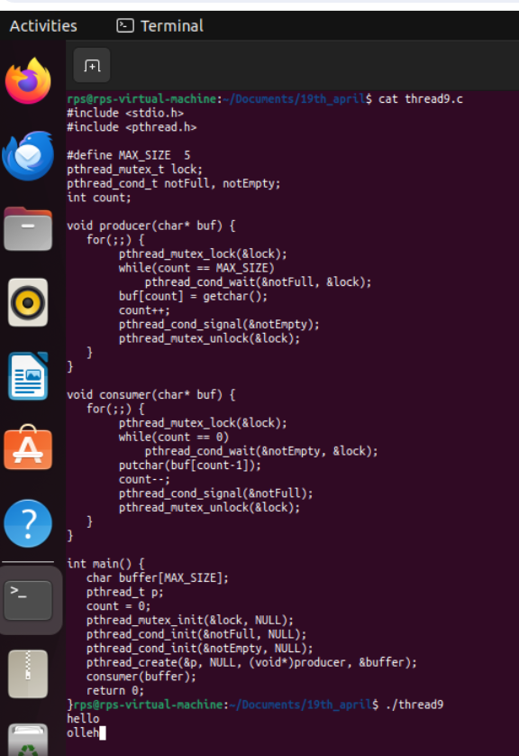
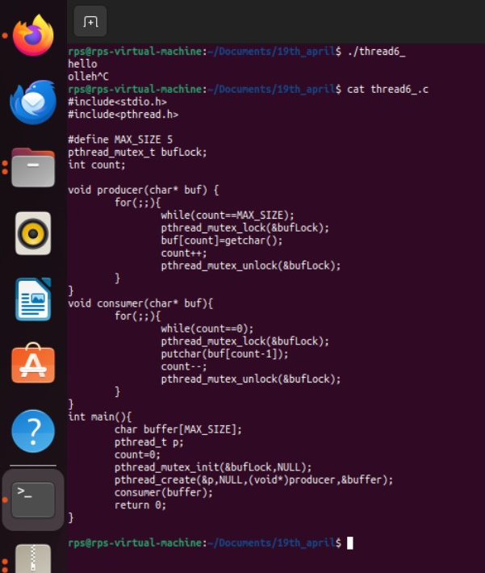
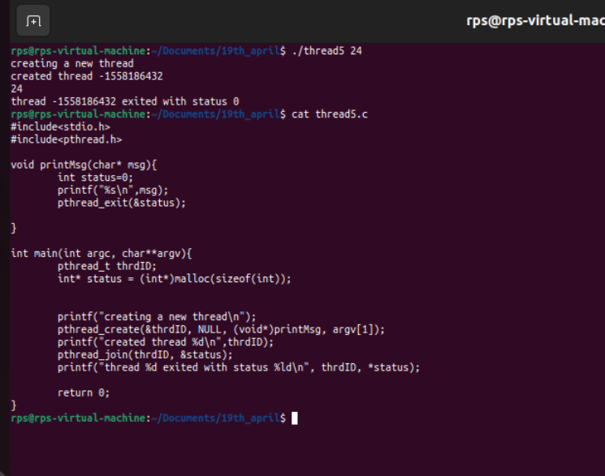

Slide 6
THANK YOU

